Slide 1
Welcome to Hazel Class

Slide 2
Staff
Mrs Brinkhurst
Mr Hopwood
Notes:
Add picture and names of all staff in the year group

Slide 3
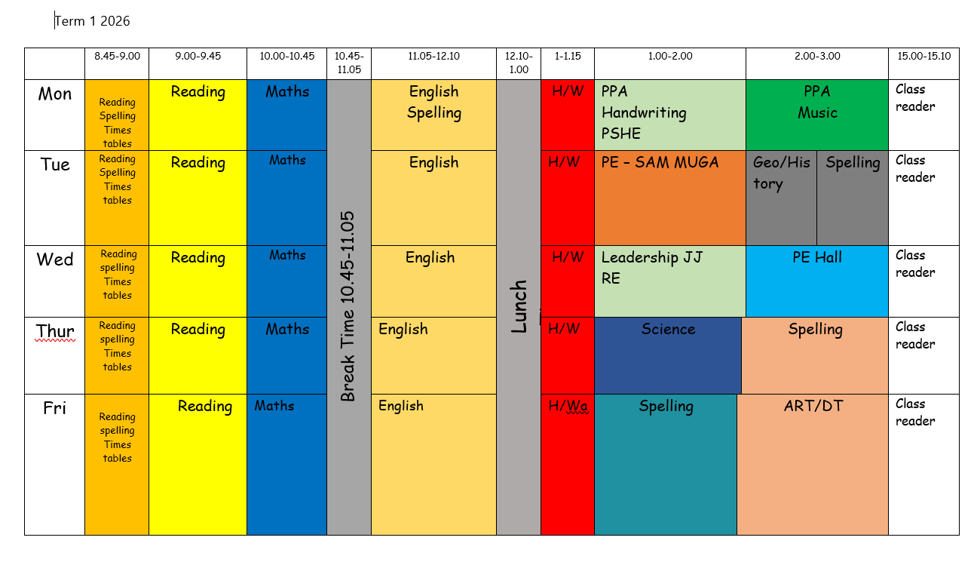
Year 4/5 Timetable – Our week at a glance

Slide 4
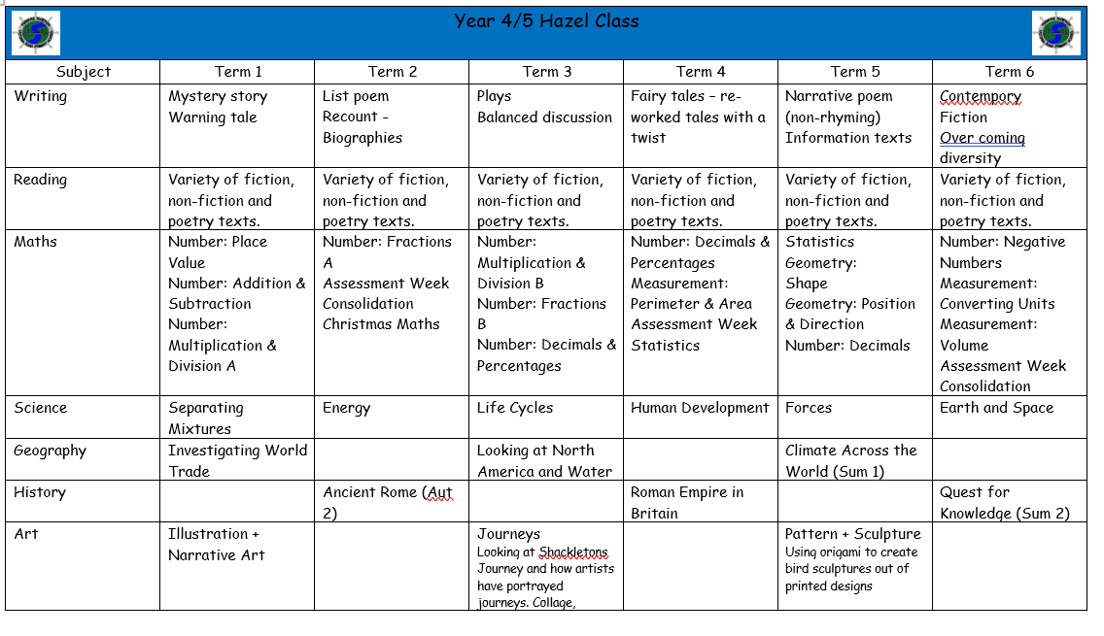

Slide 5
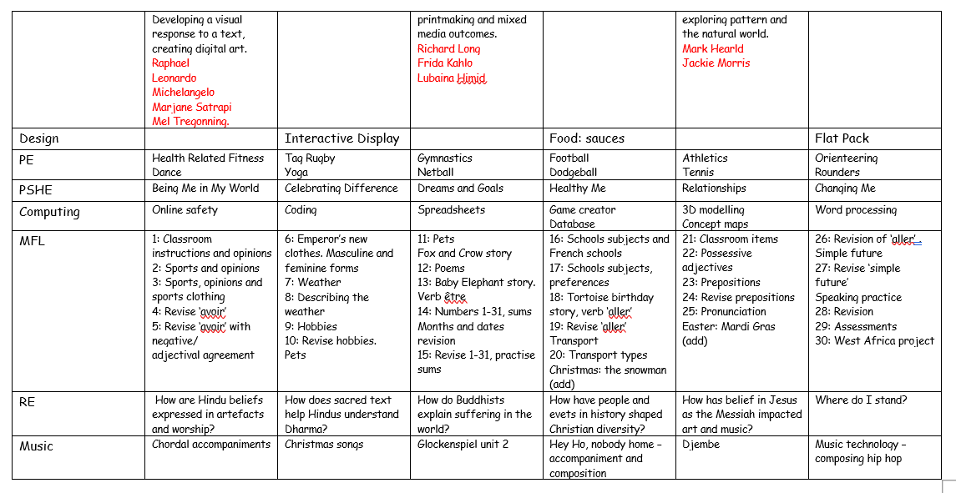

Slide 6
PE Days
Tuesday – Outdoor
Wednesday – Indoor
Children to wear their correct colour t shirt for this and wear PE kit into school.

Slide 7
Homework
Reading 4 times a week at least.
TTRS as this still needs to be kept up with so they are ready for year 6.

Slide 8
Trips /Events
Needs to be confirmed but we will be doing swimming again for one week to boost our skills from last year this will be at the end of September.
Trips to the Library.

Slide 9
What can you do?
The importance of parents, carers, teachers and children working together is invaluable, especially at this crucial time!
Read with your child regularly.
Good attendance and being on time is really important.
Encouraging children to use TTRS to continue to practise their times tables as this is still so important!

Slide 10
Any questions?
We have an open-door policy so feel free to reach out anytime you need.
All staff will also be on the back playground every afternoon at 3.10pm so please feel free to ask us anything!

