Slide 1


Y
Welcome Meeting
Year 2
Autumn Term 2025

Slide 2
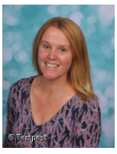
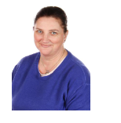
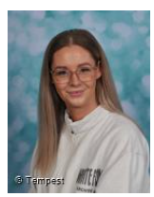
YW
Year 2 Staff
Mrs Bechley- Year 2 Class teacher
Mrs Crisp Teaching Assistant AM
Miss Jones
PM

Slide 3

YW
What will my child be learning?
Termly school trip- Details to follow.

Slide 4
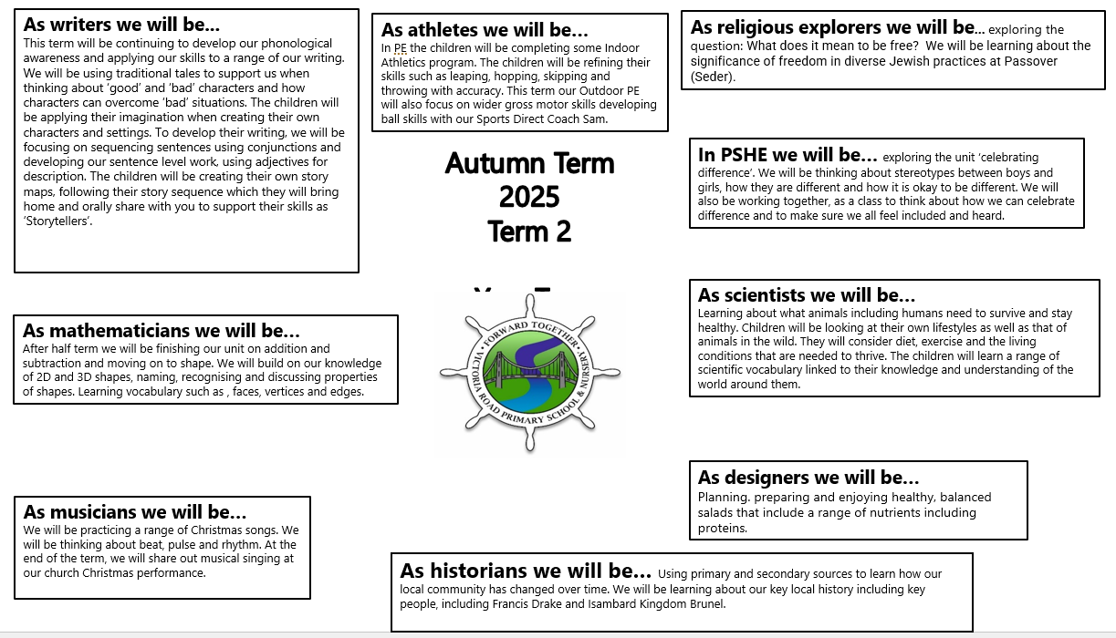
YW
What will my child be learning?

Slide 5
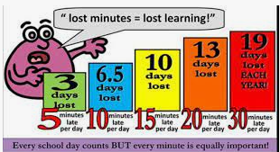
YW
Attendance
It is absolutely vital that if your child is well that they come to school on time every day. Thank you.

Slide 6

YW
Reading
Please continue to read with your child on a daily basis. Find a time which suits you and your child.
Your child will bring home a book bag book linked to their phonics level. In addition, they will bring home a book which they have chosen themselves to read for pleasure. This is a sharing book which is nice to share at a quiet time such as bedtime. Children will be assessed every half term and may then move coloured books after those assessments.
Accelerated Reader- children take a quiz at the start of a term which provides a ZPD level. Children complete quizzes after each book which then provides a word count. Certificates are awarded.
Books are changed on a Friday, to encourage the children to develop fluency with the words which they are reading. School staff will remind the children to change their books, and we promote the children trying to do this independently. The sharing book can be changed daily.

Slide 7
YW
Transition between Year 1 and Year 2
The children are very familiar with the staff and expectations.
The focus will now move to developing reading fluency and the comprehension skills needed.
VIPERSS. (Vocabulary, Inference, Prediction, Explanation, Retrieval, Sequencing and Summarising)
Spelling focus- see common exception words for Y1 and Y2. We will be shortly commencing our RWI spelling sessions.

Slide 8
YW
Transition between Year 1 and Year 2
Writing
Develop positive attitudes towards and stamina for writing by:
Writing narratives about personal experiences and those of others (real and fictional)
Writing about real events
Writing poetry
Writing for different purposes
Learning how to use both familiar and new punctuation correctly-including full stops, capital letters, exclamation marks, question marks, commas for lists and apostrophes for contracted forms and the possessive (singular)
Learn how to use:
Sentences with different forms: statement, question, exclamation, command
Expanded noun phrases to describe and specify [for example, the blue butterfly]
The present and past tenses correctly and consistently including the progressive form.
Subordination (using when, if, that, or because) and co-ordination (using or, and, or but)

Slide 9
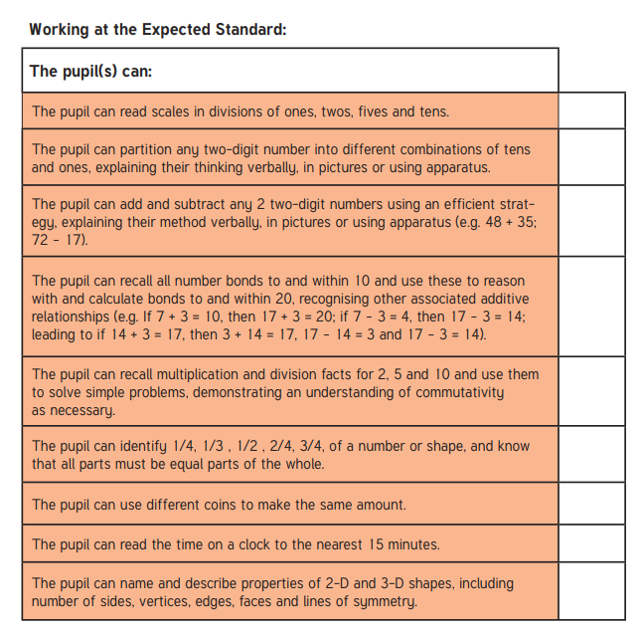
YW
Maths expectations

Slide 10
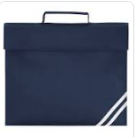

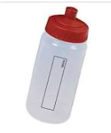
YW
What will my child need?
Your child will need to bring to school a bookbag every day with their reading diary and the books which they have chosen in school.
A waterbottle with water. No Fizzy or coloured drinks please.
This term our PE days will be on Wednesday and Thursday. Please ensure that your child wears the appropriate school PE kit for these sessions and that they bring to school a water bottle filled with water every day.
Please label EVERYTHING!

Slide 11

YW
Home Learning
Please read with your child as often as possible, but ideally at least three times per week. If your child has their reading recorded in the reading diary at least three times per week they will receive a raffle ticket. Every Friday in celebration assembly, a winning raffle ticket will be chosen randomly to win a prize.
Numbots/Times Table Rock Stars logins have been sent home. Certificates are awarded during the celebration assembly.

Slide 12
YW
Finally….
Year 2 is a really exciting year for your child, and they will grow in so many different ways.
If there are any problems, please always come and speak to one of us. We are always very approachable and happy to help.
Thank you for your support.

Slide 13
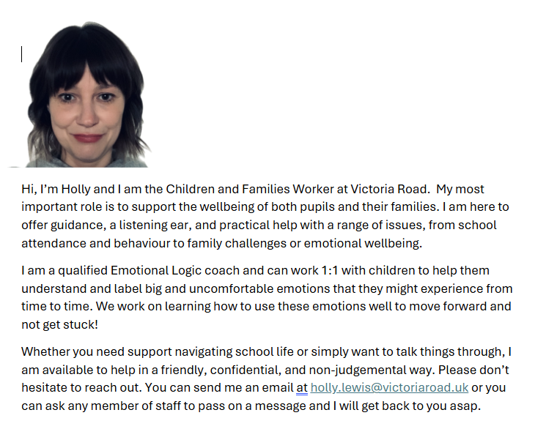
YW
Children and Families Worker

